Slide 1

Detecting Skin Cancer using Image Processing

Slide 2


Agenda
Business Problem
Goal
Data
Approach
Results
Caveats
Future Scope

Slide 3
Business Problem
Traditionally, skin cancer is diagnosed by following expensive steps:
Initial clinical screening
Dermoscopic Analysis
Biopsy
Histopathological Examination
Automated classification of skin cancer lesions is a challenging task.

Slide 4
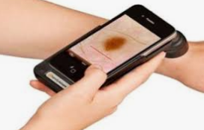
Goal
Provide easy, fast, accurate and cheap solutions for preliminary automated diagnosis of skin cancer.
Binary classification of lesions using Image processing techniques into:
Malignant lesions
Non-Malignant/Benign lesions

Slide 5
Data Preparation
Images from International Skin Imaging Collaboration(ISIC) website have been used for Analysis.
The dataset consists of 800 images (50% benign and 50% malignant) for training the model.
A validation data is created by using 20% of the training data.
160 images (50% benign and 50% malignant) are picked up randomly from google images for test dataset.

Slide 6
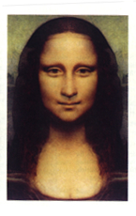



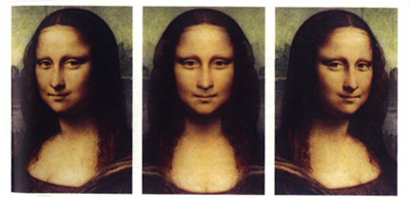
Approach
Convolutional Neural Network technique is used for binary image classification using Python.
Images are modelled with and without editing like flipping and rotations.
Classification accuracy is assessed for model selection.
Model comparison
Images
Python
Accuracy based selection

Slide 7

Results
The final product classifies images of malignant from benign lesions with an accuracy of 79%.
Malignant lesions can be detected with an accuracy of 76%.
Benign lesions can be detected with an accuracy of 68%.

Slide 8

Caveats
24% of the malignant lesions are classified incorrectly.
With enough time and resources, accuracy can be increased.
Large pool of images are available for increasing the accuracy.
Retaining images of product users with consent would be good practice for increasing the database.

Slide 9
Future Scope
Smartphones are projected to be in 6.3 billion hands by 2021.
By utilizing built in cameras, an app could apply the trained diagnostic model.
An app is ideal due to minimal costs after development.
Likelihood of generating goodwill for an organization.
Can be used as a marketing tool for a large health companies.
Provides access to health-tracking market.

Slide 10
Thank You

Slide 11
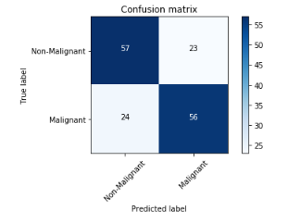
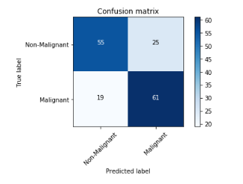
Appendix
Without Augmentation
With Augmentation

